Slide 1
Program Final Project
AJUZIEOGU EGBULEFU

Slide 2
INTRODUCTION
This analysis focuses on identifying the key regions and periods when violent crimes occur in Chicago. This is done to fully prepare the Chicago Police Department on how to effectively prepare for and drastically reduce the rate at which violent crimes are reported in the city.
This analysis provides answers to;
What violent crimes occur in the city of Chicago?
Where do they often occur?
Which days of the week or periods do they frequently occur?
How could the Chicago police department reduce the rate of these crimes?

Slide 3
METHOD
The dataset provided for analysis was imported to the worksheet right after adding all the necessary libraries for analysis.
The ‘Date’ column in the data was converted to a datetime datatype. This is done to allow the Month, Weekday, and Time when the crime occurred to be extracted into new individual columns.
About 9.13% percent of the entries had missing data. For an analysis as sensitive as this, removing all entries with missing data seems to be the best method of treatment.
The type of crimes seen in the data was divided into two distinct groups; Violent Crimes (as defined by the FBI’s Uniform Crimes Reporting UCR program), and Non-violent Crimes.
A new dataset was created afterwards to group all data by their type of crime.

Slide 4
METHOD
Each of the crime classified as a violent crime is then analysed the following way;
The descriptions of the crime are identified.
Descriptions with the highest rates are collected separately and passed through further analysis.
Community Areas where they occur the most are identified.
The Location Description of these community areas are identified.
An examination is made to see if these crimes were reported as domestic crimes, and if any arrest was made.
The year, month, weekdays, and time of the day these crimes occur are identified to further understand their pattern.

Slide 5
RESULTS

Slide 6
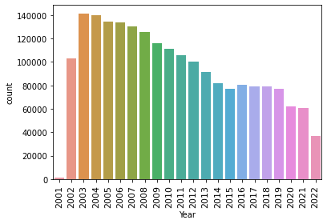
Since 2003, there have been significant drops in the rate at which crime in general occur in the city of Chicago.

Slide 7
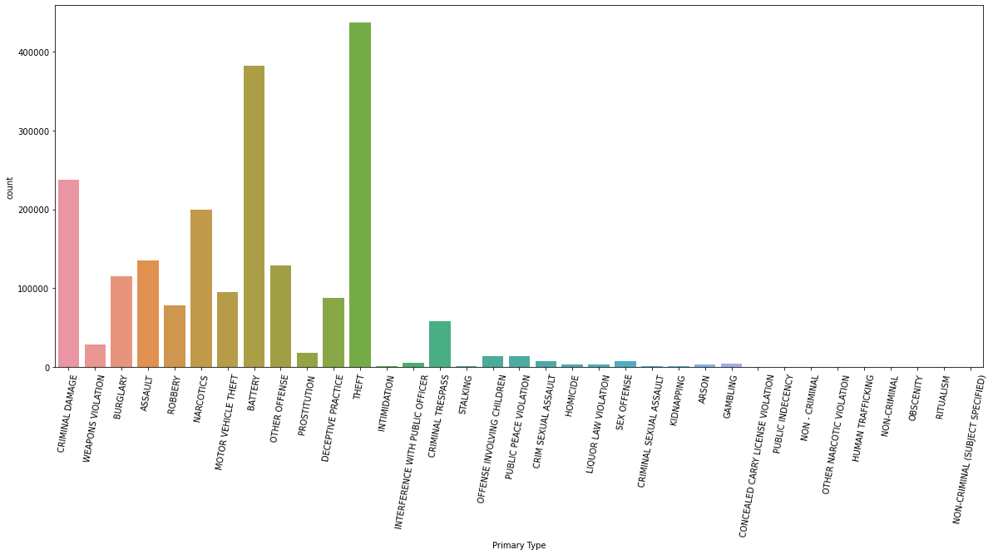
TYPE OF CRIMES
Violent crimes on the high in Chicago;
- THEFT make up for 21.1% of crimes in the data
- BATTERY make up for 18.4% of crimes in the data
- CRIMINAL DAMAGE make up for 11.5% of crimes in the data
- ASSAULT make up for 6.5% of crimes in the data
- BURGLARY make up for 5.5% of crimes in the data
- MOTOR VEHICLE THEFT make up for 4.6% of crimes in the data
- ROBBERY make up for 3.8% of crimes in the data

Slide 8
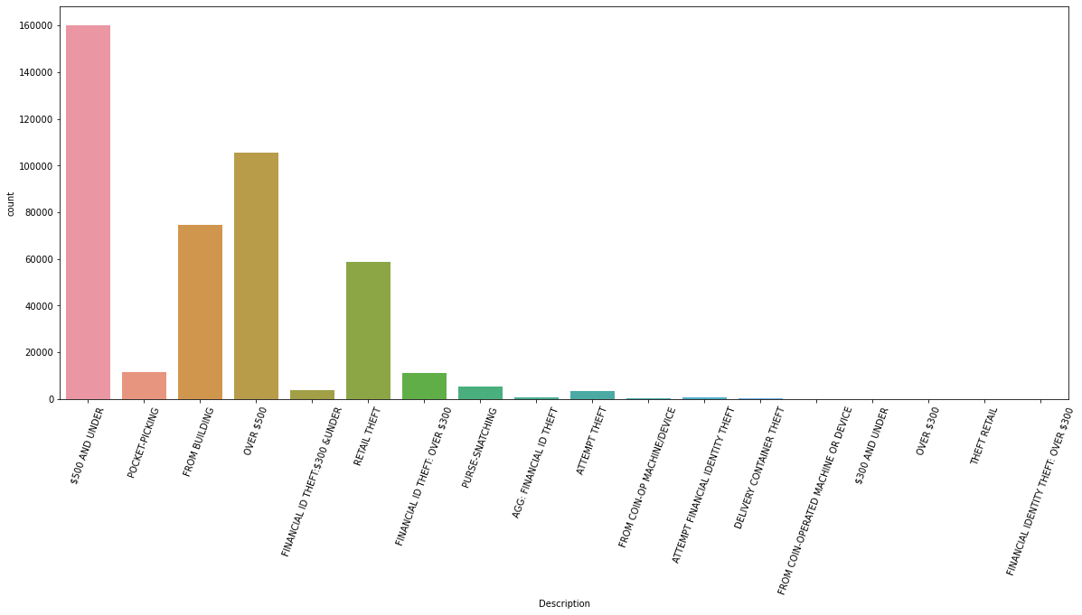
THEFTS
This chart shows crimes under theft with the highest occurrence.
- $500 AND UNDER make up for 36.7% of thefts
- OVER $500 make up for 24.2% of thefts
- FROM BUILDING make up for 17.1% of thefts
- RETAIL THEFT make up for 13.4% of thefts

Slide 9
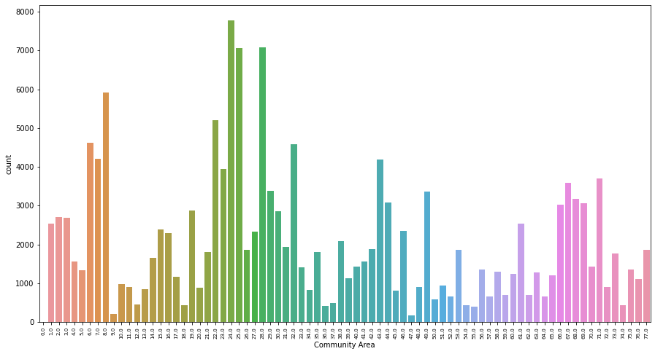
THEFTS
These are areas that can be classified as hot zones for theft of $500 AND UNDER;
- Areas 21-32
- Areas 1-8
- Areas 65-73
- Areas 38-49

Slide 10
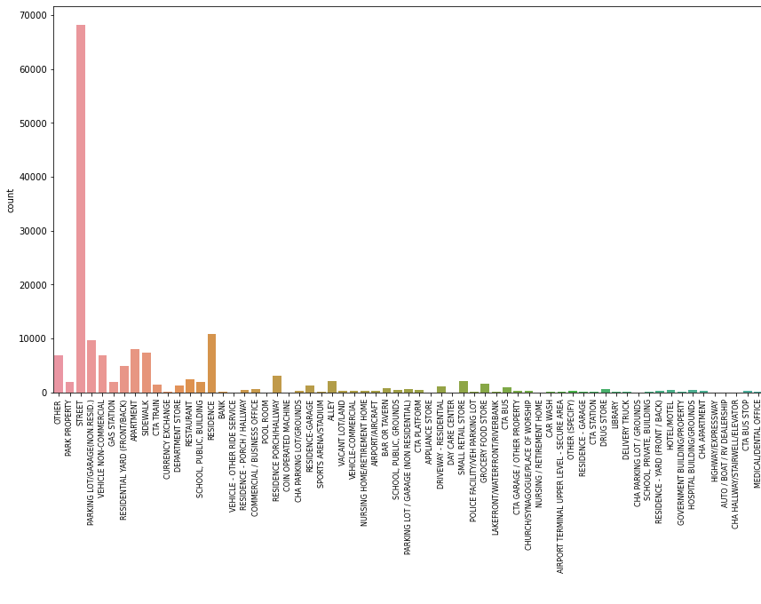
THEFTS
Thefts of $500 AND UNDER happen more often in the streets of these community areas

Slide 11
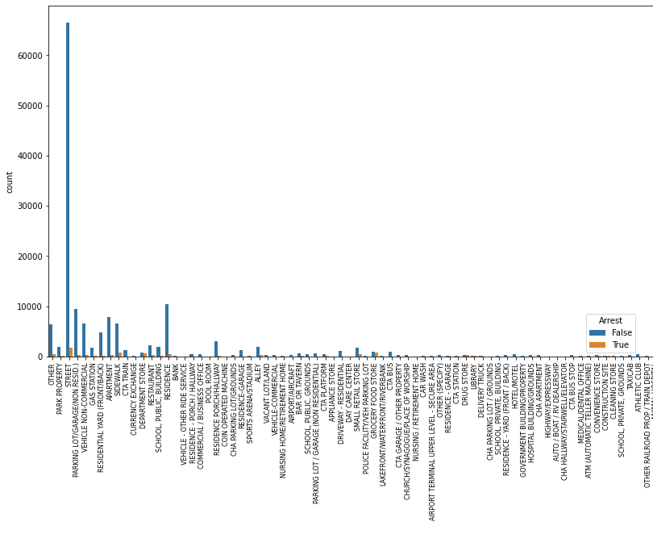
THEFTS
There have been very few arrest made for thefts of $500 AND UNDER in all of the locations combined.

Slide 12
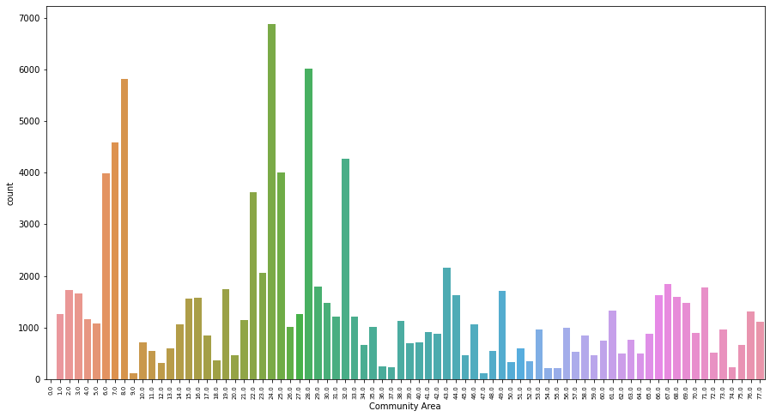
THEFTS
These are areas that can be classified as hot zones with high rates for theft of OVER $500;
- Areas 21-33
- Areas 6-8

Slide 13
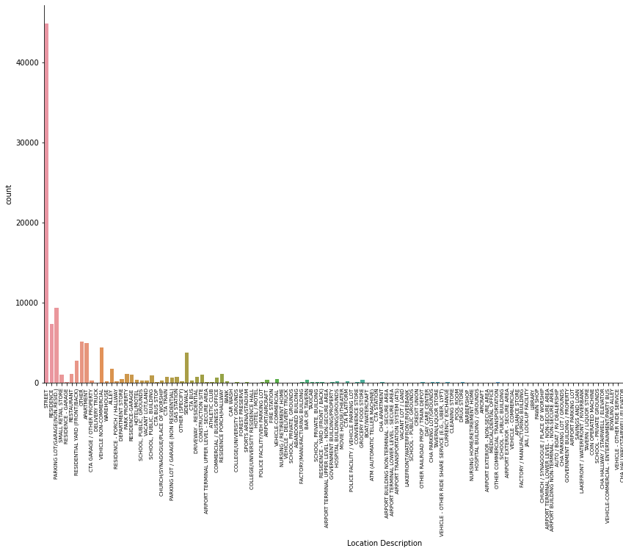
THEFTS
Theft of OVER $500 happen more often in the streets of these community areas

Slide 14
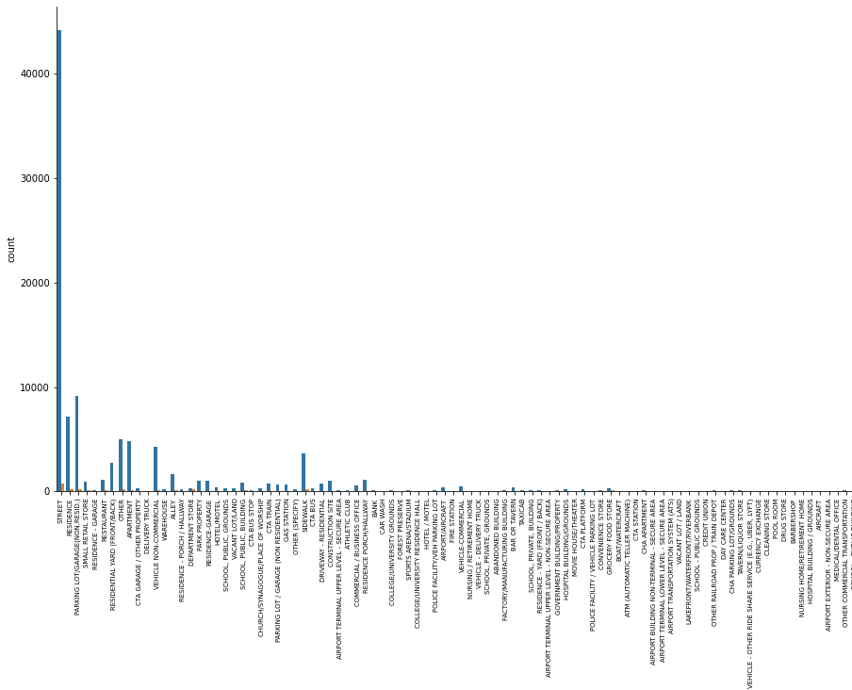
THEFTS
There have been very little arrest made for thefts of OVER $500 all of the locations combined.

Slide 15
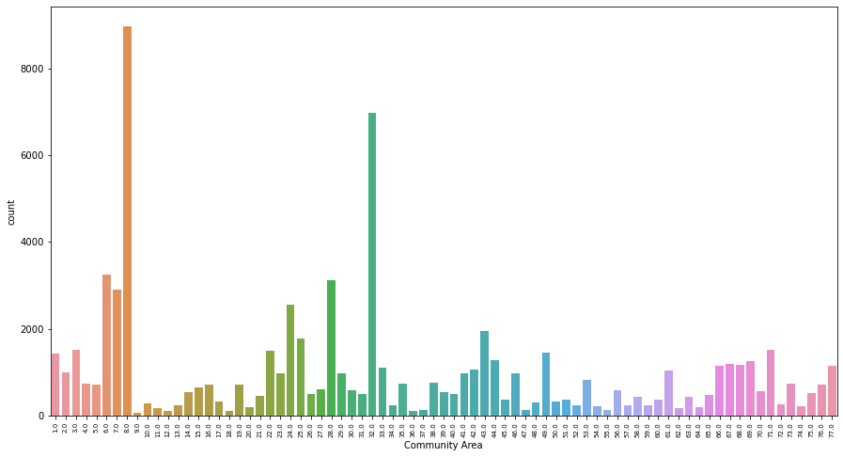
THEFTS
These are areas that can be classified as hot zones with high rates for theft FROM BUILDING;
Areas 6-8
Areas 28-32

Slide 16
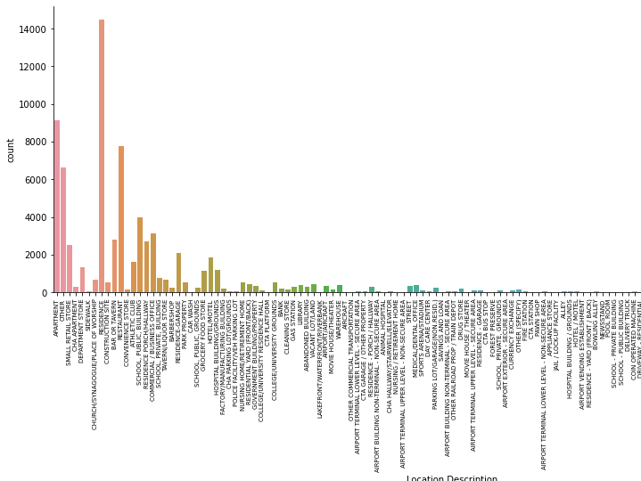
THEFTS
Theft FROM BUILDING happen more often in the Residence, Apartment, Restaurant, and Other Buildings of these community areas

Slide 17
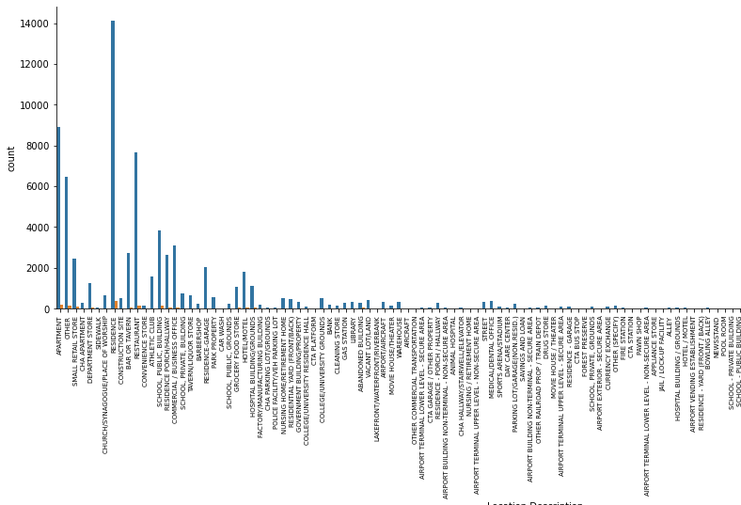
THEFTS
There have been very little arrest made for thefts FROM BUILDING IN all of the locations combined.

Slide 18
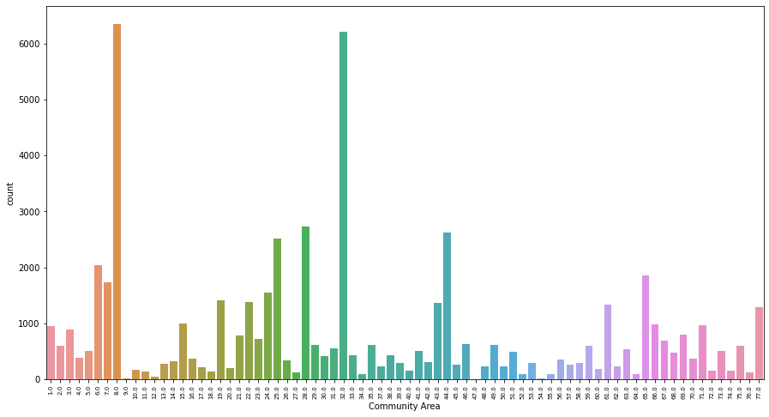
THEFTS
These are areas that can be classified as hot zones with high rates for theft of RETAIL THEFT;
- Areas 25-32
- Areas 6-8

Slide 19
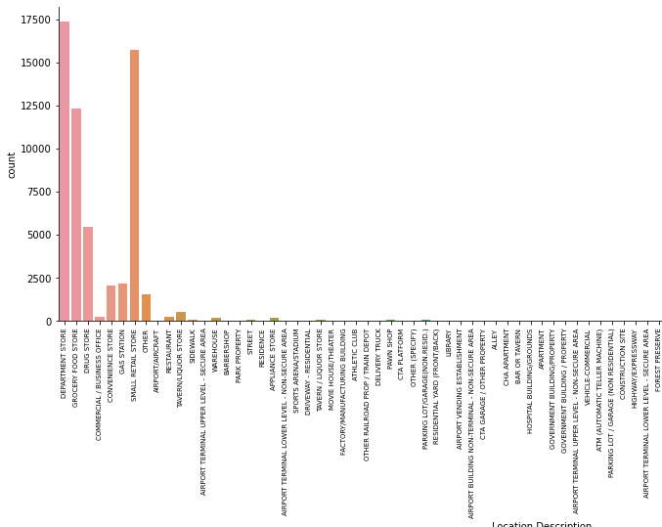
THEFTS
RETAIL THEFT happens more often in the Department Stores, Small Apartment Store, Grocery Food Store, and Drug Stores of these community areas

Slide 20
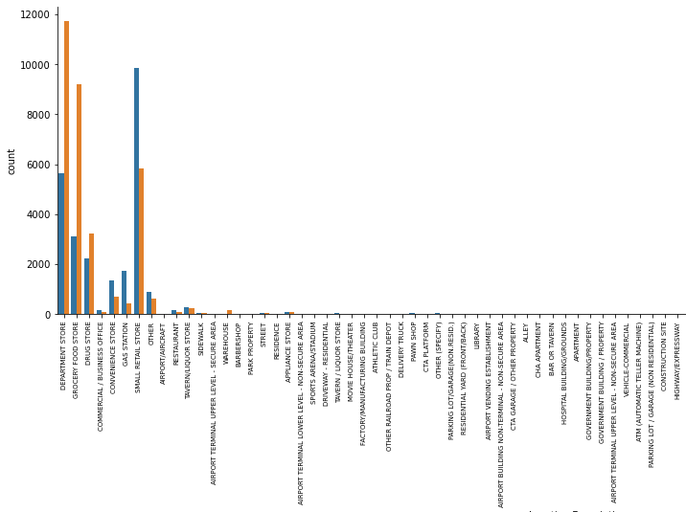
THEFTS
- Arrest was made 67.5% of the time RETAIL THEFT was reported in DEPARTMENT STORE
- Arrest was made 26.2% of the time RETAIL THEFT was reported in SMALL RETAIL STORE
- Arrest was made 69.7% of the time RETAIL THEFT was reported in GROCERY FOOD STORE
- Arrest was made 60.0% of the time RETAIL THEFT was reported in DRUG STORE

Slide 21
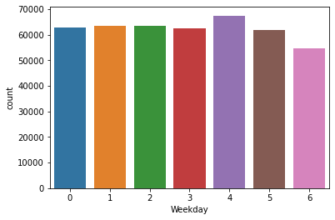
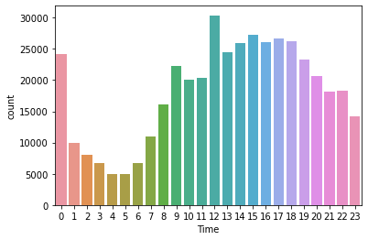
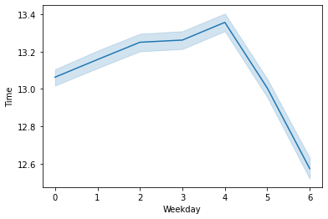
THEFTS
The charts show that Theft in general occurs more often in the afternoon and evenings and at the same rate all through the week
The line plot also reveals that they to occur at much earlier of the day during weekends.
Note:
0 represents Monday
1 represents Tuesday
2 represents Wednesday
3 represents Thursday
4 represents Friday
5 represents Saturday
6 represents Sunday

Slide 22
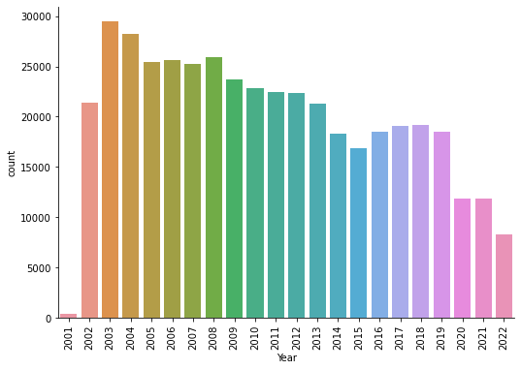
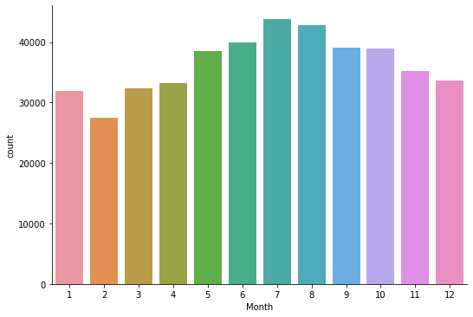
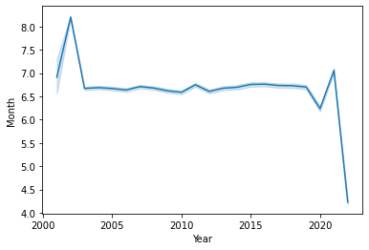
THEFTS
The rates at which Thefts happen drops with each passing year. However, they often happen at higher rates during summer.
Thefts happened more at fall during the early 2000s. It then became more rampant at summer time (Mostly July, August) from the Mid 2000s to 2021. It is now happening more often during Spring in 2022 to present year (probably because this is where the data ends for that year)

Slide 23
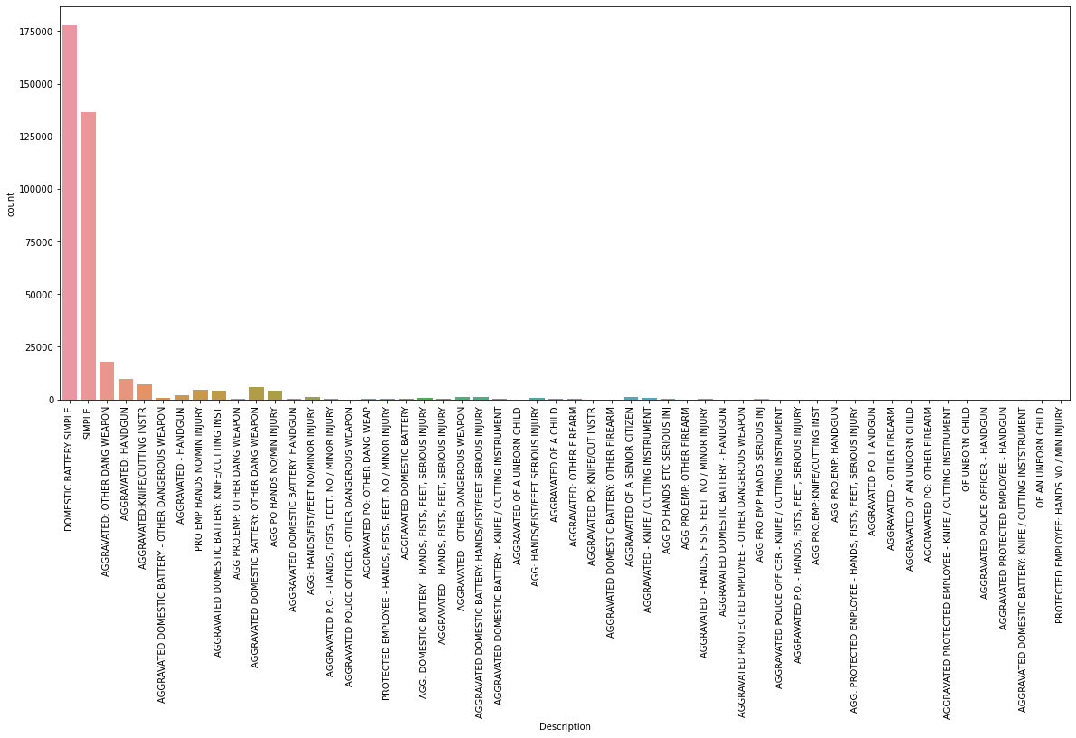
BATTERY
- DOMESTIC BATTERY SIMPLE make up for 46.6% of the crimes under BATTERY
- SIMPLE make up for 35.8% of the crimes under BATTERY
This means they collectively make up 82.4% of the crimes in BATTERY.

Slide 24
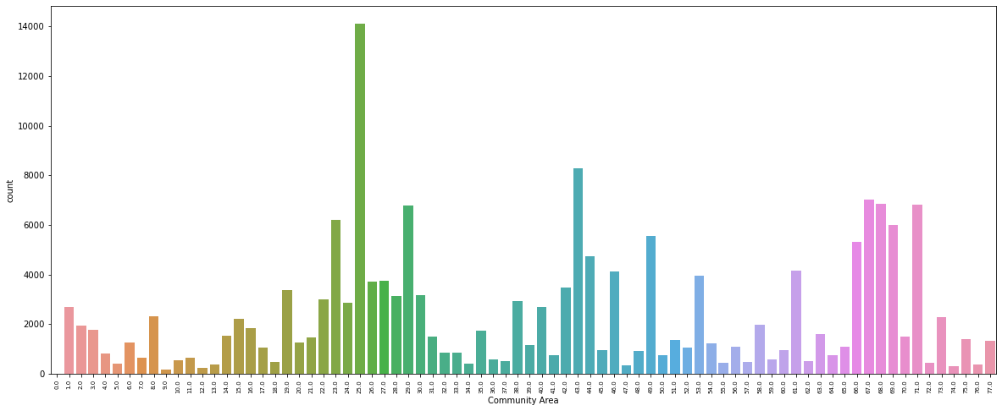
BATTERY
These are areas that can be classified as hot zones with high rates for DOMESTIC BATTERY SIMPLE
- Areas 19-30
- Areas 66-71
- Areas 42-49

Slide 25
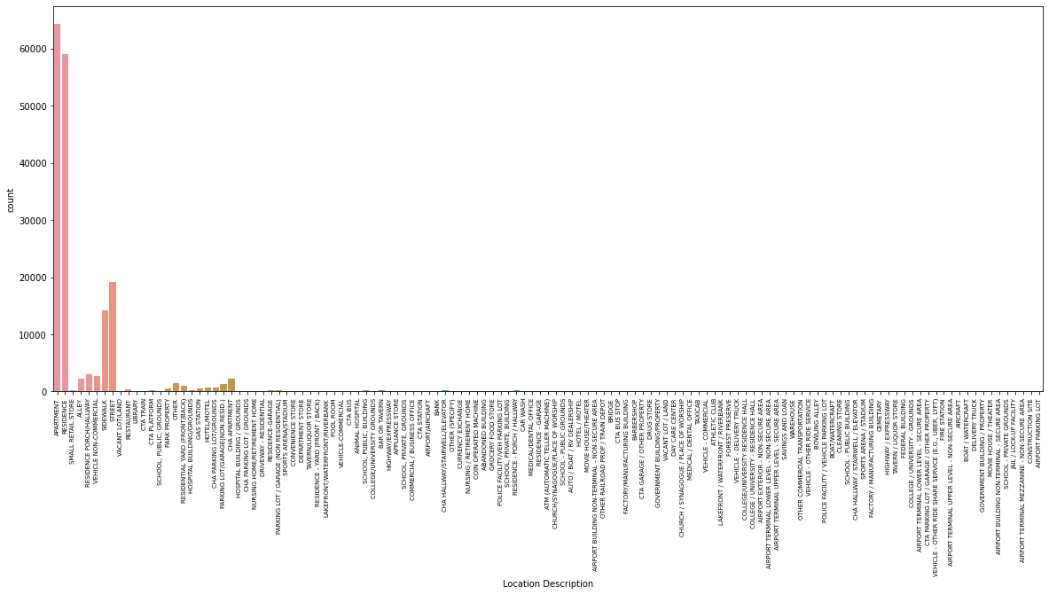
BATTERY
DOMESTIC BATTERY SIMPLE happens more often in Apartment, Residence Street, and Sidewalks of these community areas.

Slide 26
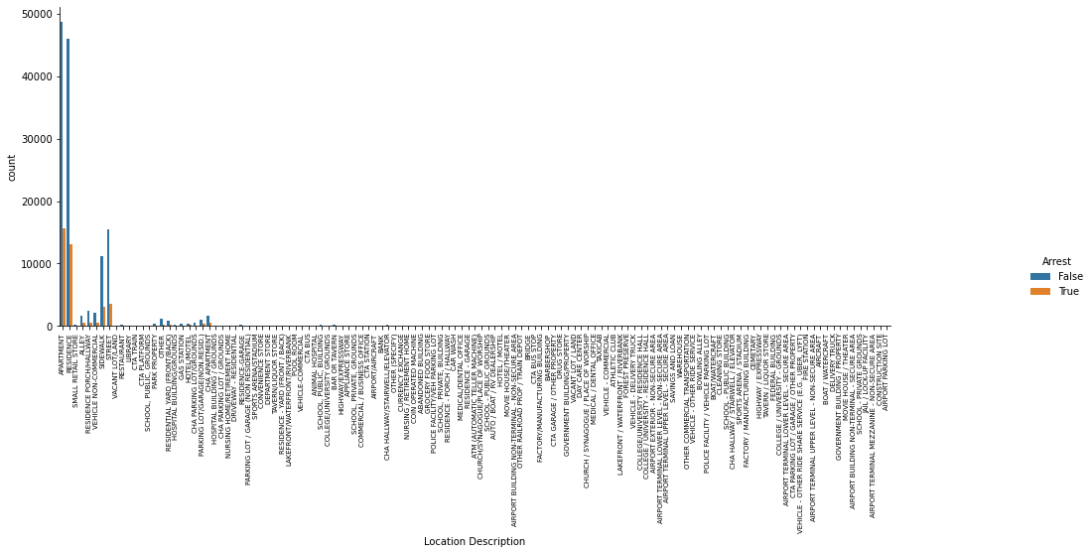
BATTERY
- Arrest was made 24.3% of the time DOMESTIC BATTERY SIMPLE was reported in APARTMENT
- Arrest was made 22.1% of the time DOMESTIC BATTERY SIMPLE was reported in RESIDENCE
- Arrest was made 18.8% of the time DOMESTIC BATTERY SIMPLE was reported in STREET
- Arrest was made 21.1% of the time DOMESTIC BATTERY SIMPLE was reported in SIDEWALK

Slide 27
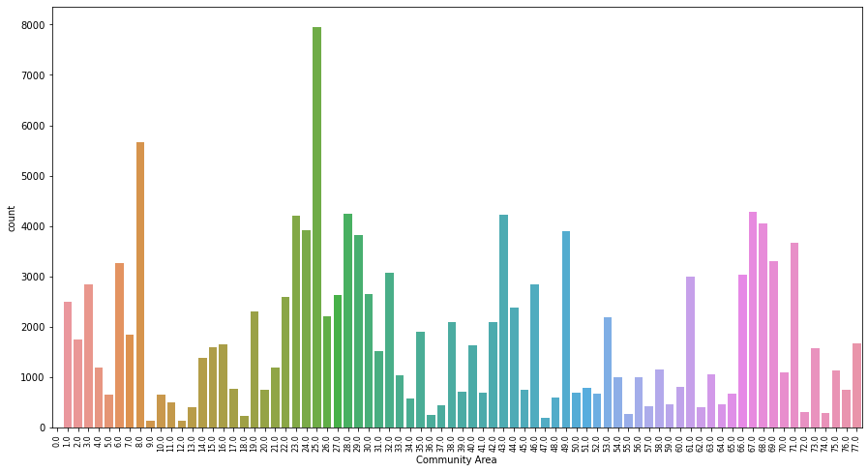
BATTERY
These are areas that can be classified as hot zones with high rates for SIMPLE
- Areas 19-35
- Areas 66-71
- Areas 42-49

Slide 28
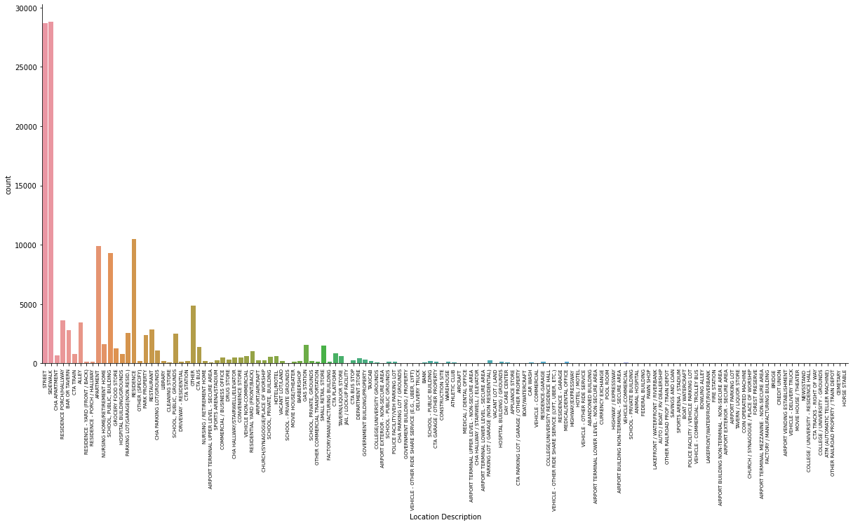
BATTERY
SIMPLE happens more often in Streets, Sidewalks, Residence, Apartments, and School, Public, Building of these community areas.

Slide 29
BATTERY
- Arrest was made 16.4% of the time SIMPLE was reported in STREET
- Arrest was made 18.2% of the time SIMPLE was reported in SIDEWALK
- Arrest was made 17.0% of the time SIMPLE was reported in RESIDENCE
- Arrest was made 18.3% of the time SIMPLE was reported in APPARTMENT
- Arrest was made 25.1% of the time SIMPLE was reported in SCHOOL, PUBLIC, BUILDING.

Slide 30
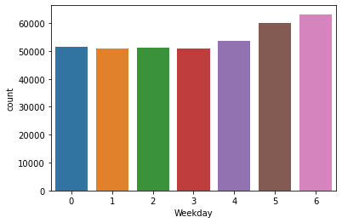
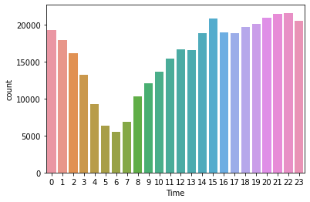
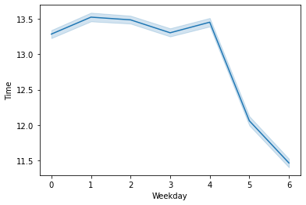
BATTERY
Battery occurs almost at the same rate during weekdays but sees a slight increase at weekends.
They are often reported at night time and early mornings of these days.
The line plot shows that at weekdays they occur more at evenings and night times. But at weekends, they are often reported late into the night and at early morning hours.

Slide 31
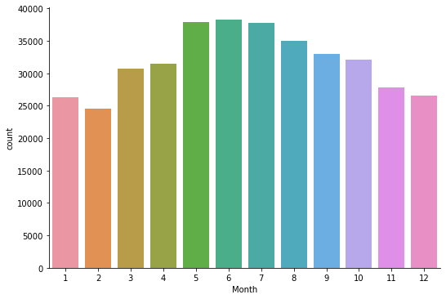
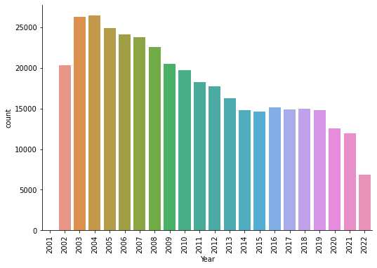
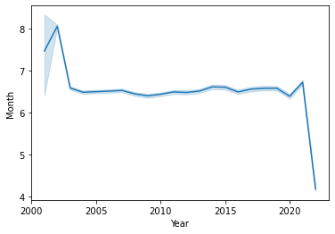
BATTERY
The rates at which Batteries happen drops with each passing year. However, they often happen at higher rates during summer.
Batteries happened more at fall during the early 2000s. It then became more rampant at summer time (Mostly July, August) from the Mid 2000s to 2021. It is now happening more often during Spring in 2022 to present year (probably because this is where the data ends for that year)

Slide 32
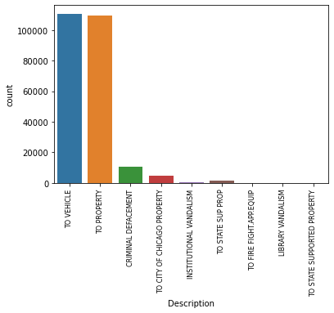
CRIMINAL DAMAGE
- TO VEHICLE make up for 46.7% of the crimes under CRIMINAL DAMAGE
- TO PROPERTY make up for 46.1% of the crimes under CRIMINAL DAMAGE
This means they collectively make up 92.8% of the crimes in CRIMINAL DAMAGE

Slide 33
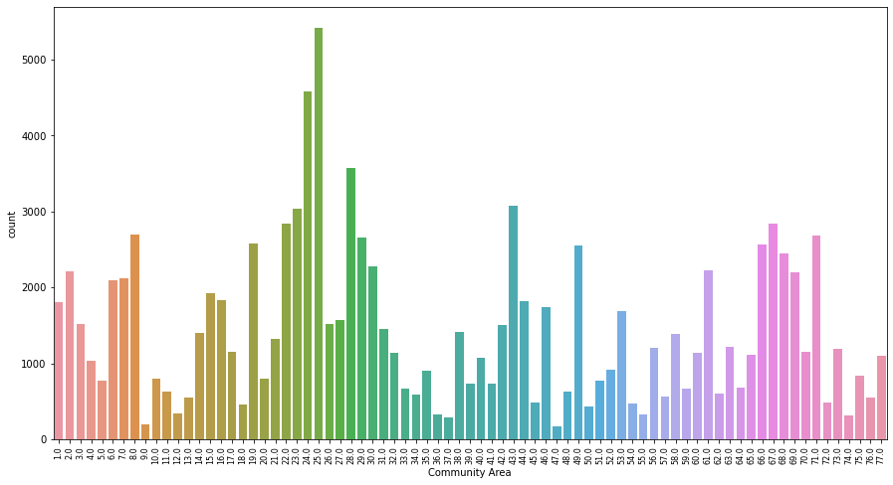
CRIMINAL DAMAGE
These are areas that can be classified as hot zones with high rates where damages TO VEHICLE occur
- Areas 19-35
- Areas 65-71
- Areas 38-49
- Areas 1-8

Slide 34
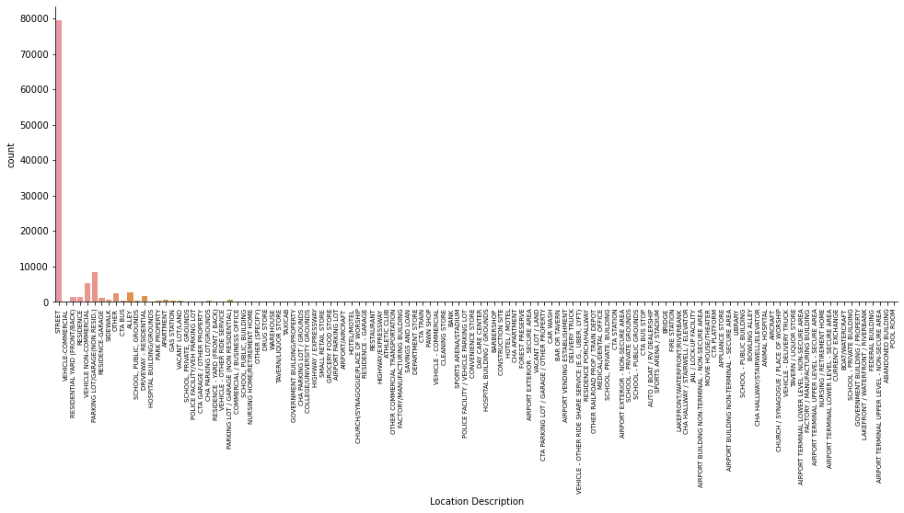
CRIMINAL DAMAGE
Damages TO VEHICLE occurs more often in the Streets of these community areas.

Slide 35
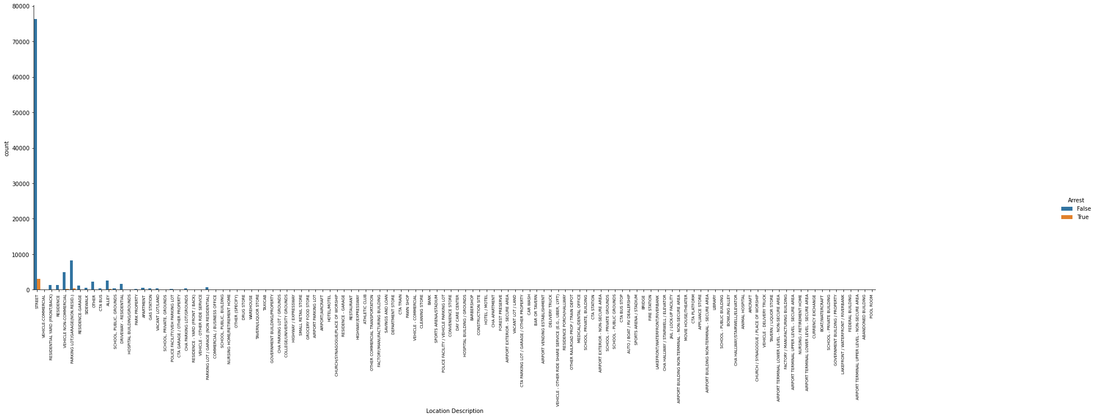
CRIMINAL DAMAGE
The percentage rate at which arrests are made for damage to vehicles is very low.

Slide 36
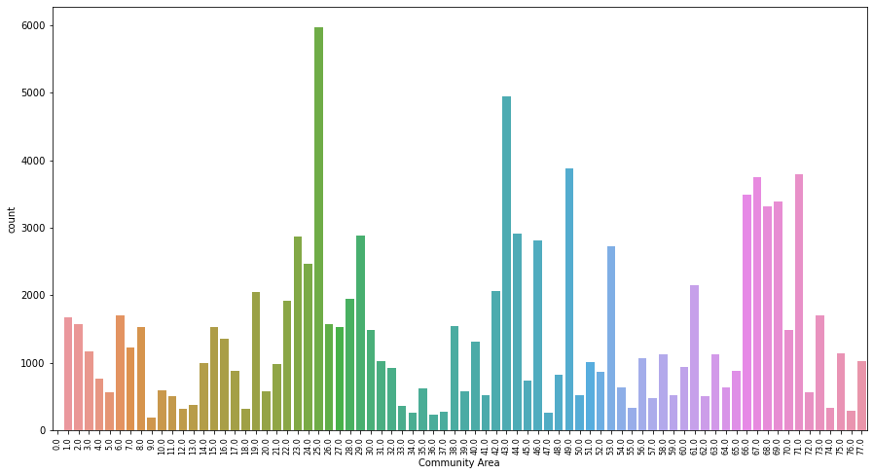
CRIMINAL DAMAGE
These are areas that can be classified as hot zones with high rates where damages TO PROPERTY occur
- Areas 19-31
- Areas 65-73
- Areas 38-53

Slide 37
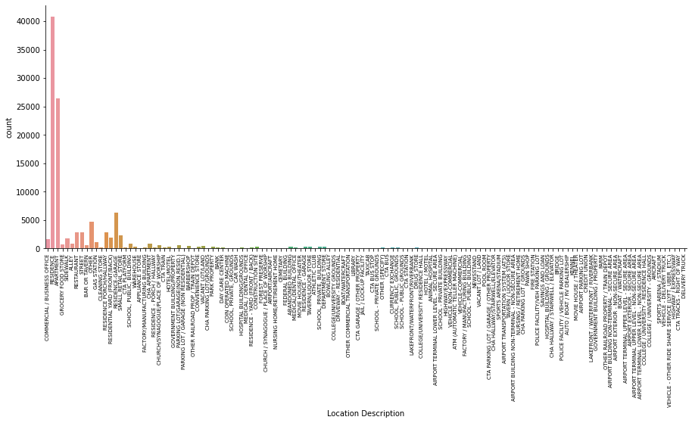
CRIMINAL DAMAGE
Damages TO PROPERTY occurs more often in the Residence and Apartments of these community areas.

Slide 38
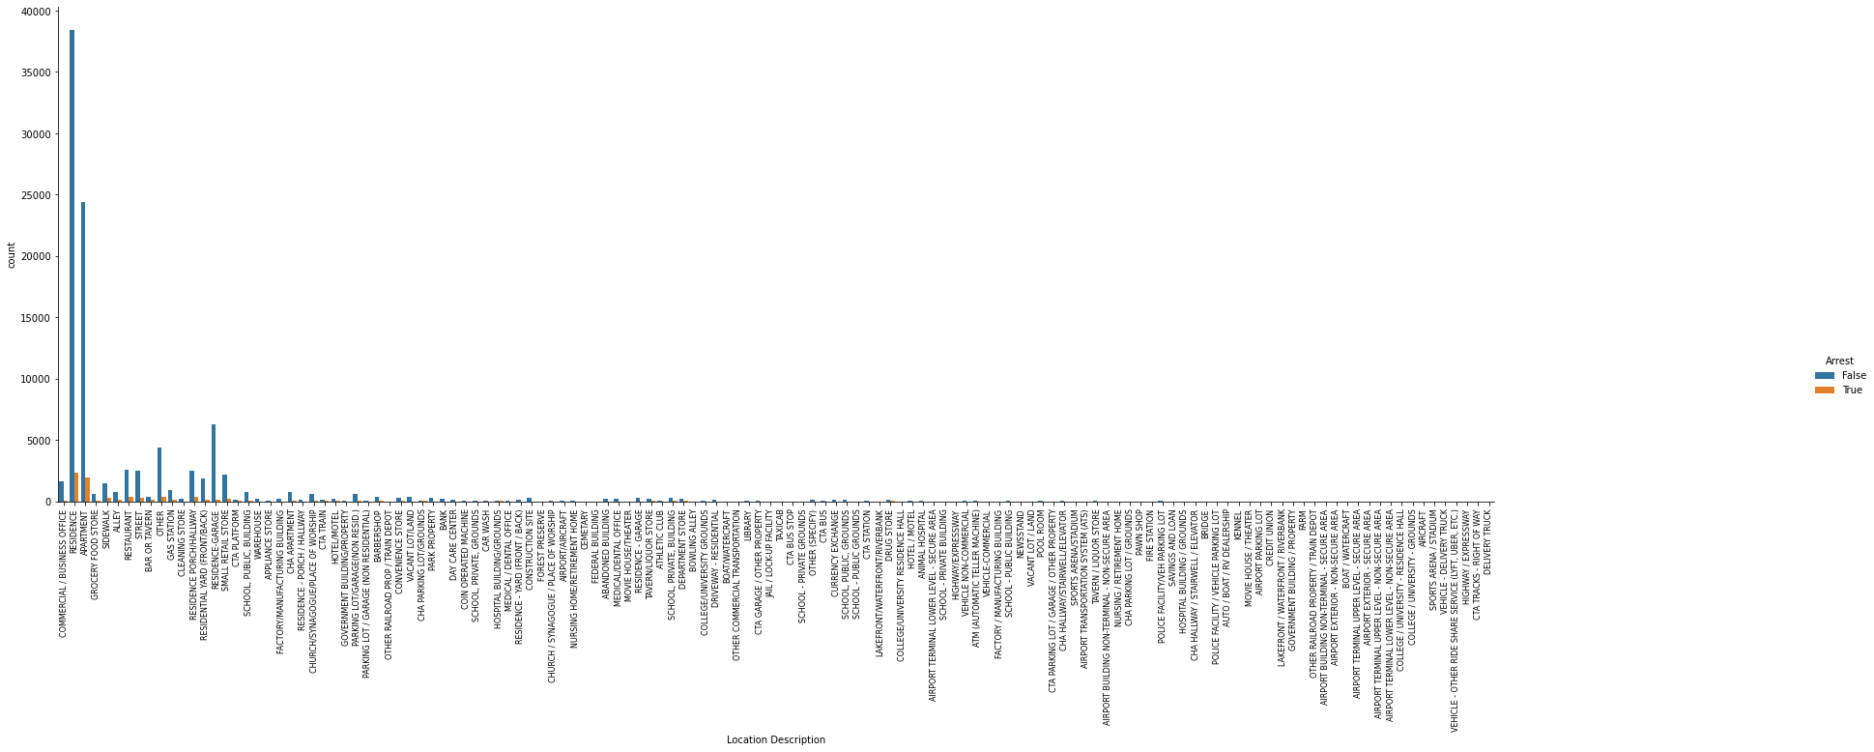
CRIMINAL DAMAGE
- Arrest was made 5.8% of the time damages TO PROPERTY was reported in STREET
- Arrest was made 7.5% of the time damages TO PROPERTY was reported in SIDEWALK
This to is still a low for the rate of arrest for criminal damages TO PROPERTY

Slide 39
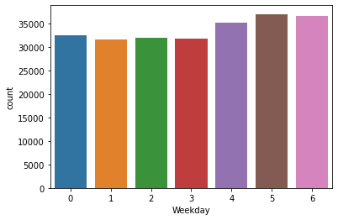
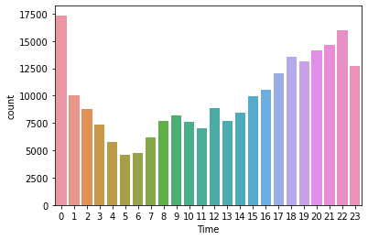
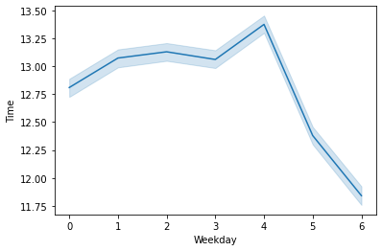
CRIMINAL DAMAGE
Criminal Damage happens at the same rates during the weekdays, but spikes up slightly at weekends.
At these days they often occur at evenings, nights and early mornings at a higher rate.
The lineplot reveals that during weekdays, they happen more at evenings and nights. But at weekends, they happen more at the early hours of the day.

Slide 40
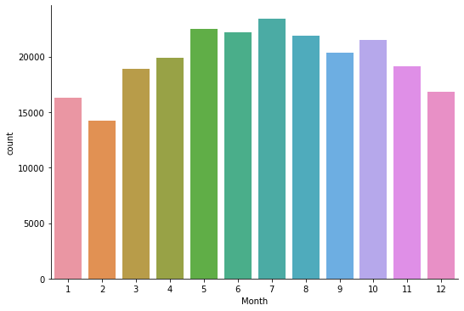
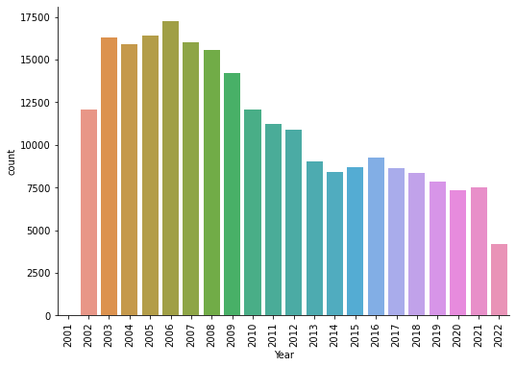
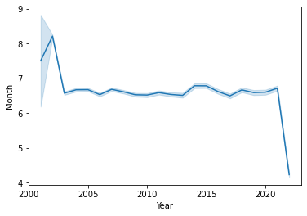
CRIMINAL DAMAGE
The rates at which Criminal Damages happen also drops with each passing year. However, they often happen at higher rates during Spring and Summer.
Batteries happened more at fall during the early 2000s. It then became more rampant at Spring and Summer time (Mostly May-August) from the Mid 2000s to 2021. It is now happening more often during Spring in 2022 to present year (probably because this is where the data ends for that year)

Slide 41
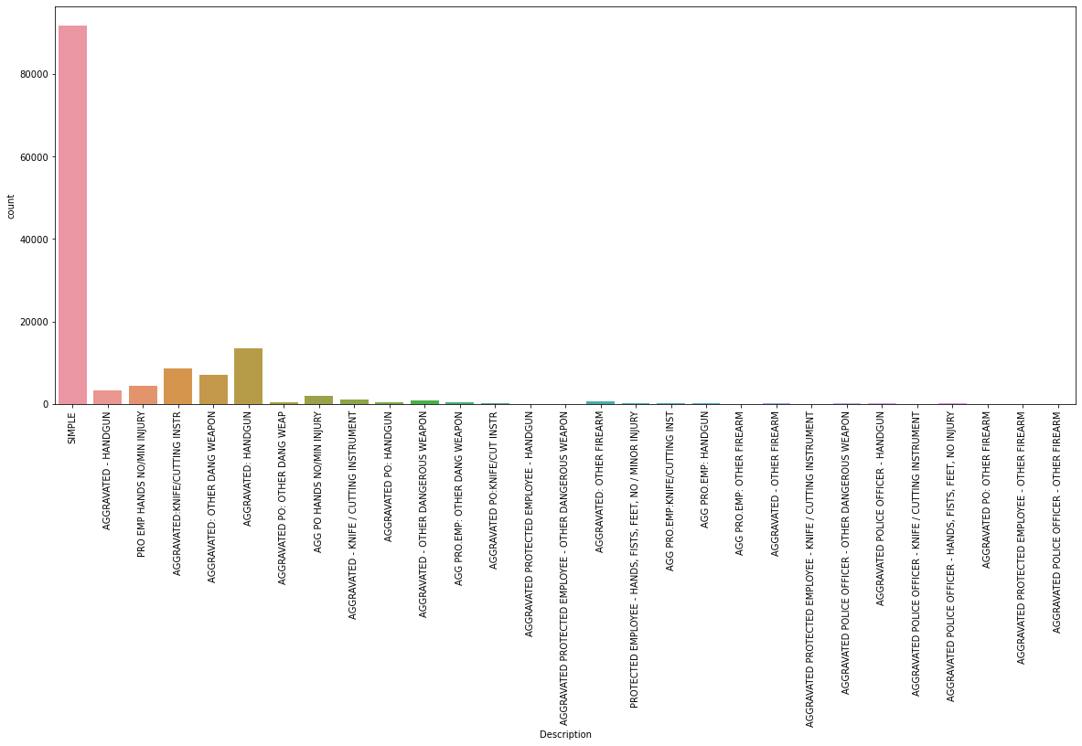
ASSAULT
- SIMPLE make up for 67.9% of assault crimes
- AGGRAVATED: HANDGUN make up for 10.0% of assault crimes
- AGGRAVATED: KNIFE/CUTTING INSTR make up for 6.4% of assault crimes
- AGGRAVATED: OTHER DANG WEAPON make up for 5.3% of assault crimes

Slide 42
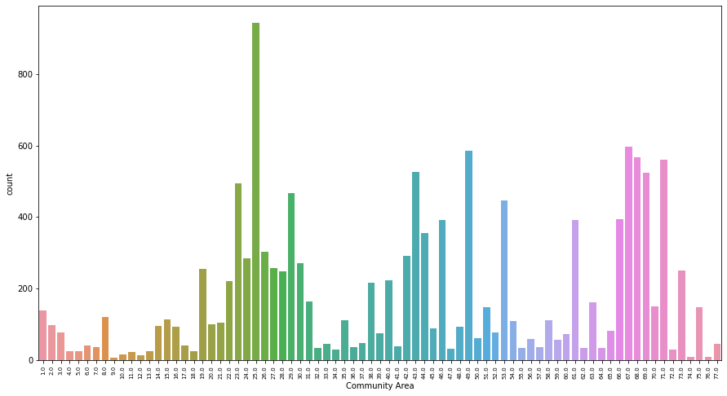
ASSAULT
These are areas that can be classified as hot zones with high rates of SIMPLE assault
- Areas 19-31
- Areas 66-73
- Areas 38-53

Slide 43
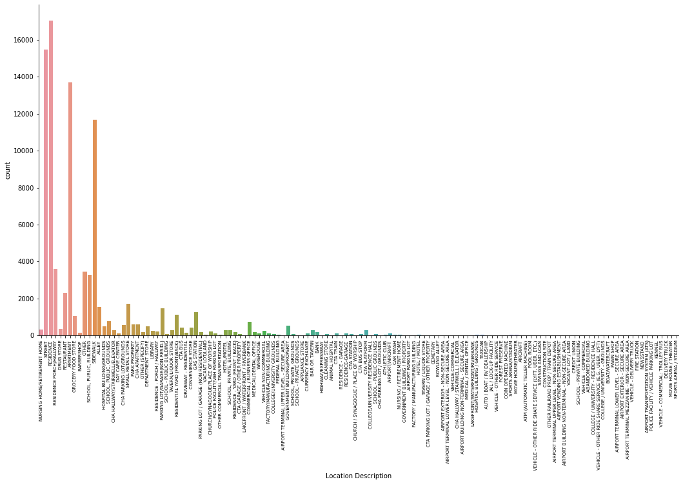
ASSAULT
SIMPLE assault occurs more often in the RESIDENCE, Streets, APARTMENT, and SIDEWALK of these community areas.

Slide 44
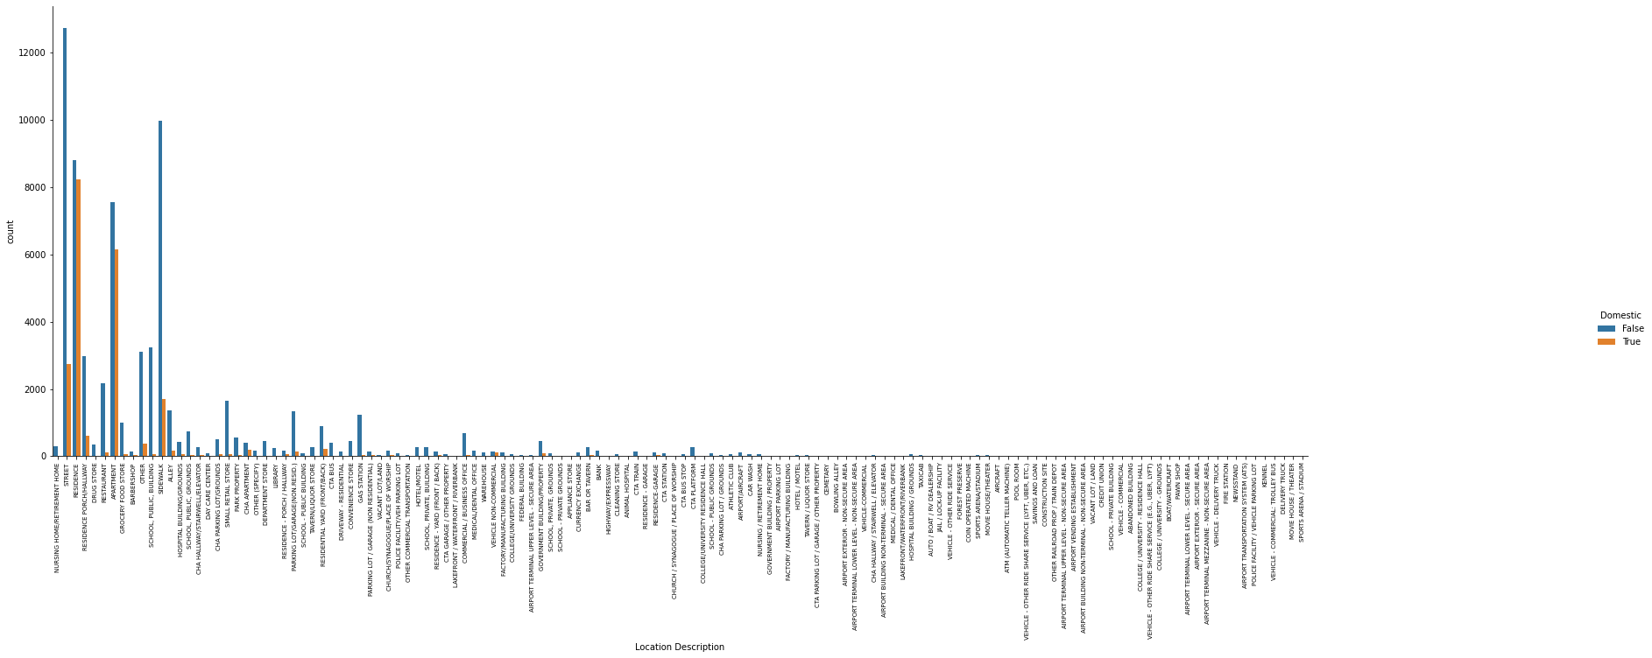
ASSAULT
- 48.3% of the SIMPLE assault in RESIDENCE were reported as Domestic
- 17.6% of the SIMPLE assault in STREET were reported as Domestic
- 44.9% of the SIMPLE assault in APARTMENT were reported as Domestic
- 14.6% of the SIMPLE assault in SIDEWALK were reported as Domestic

Slide 45

ASSAULT
- Arrest was made 13% of the time SIMPLE assault was reported in RESIDENCE
- Arrest was made 14.8% of the time SIMPLE assault was reported in STREET
- Arrest was made 15% of the time SIMPLE assault was reported in APARTMENT
- Arrest was made 20.1% of the time SIMPLE assault was reported in SIDEWALK

Slide 46
ASSAULT
These are areas that can be classified as hot zones with high rates of AGGRAVATED: HANDGUN assault
- Areas 19-31
- Areas 66-73
- Areas 38-53

Slide 47

ASSAULT
AGGRAVATED: HANDGUN assault occurs more often in the STREET, SIDEWALK, RESIDENCE, APARTMENT, and ALLEY of these community areas.

Slide 48

ASSAULT
- Arrest was made 20.9% of the time AGGRAVATED: HANDGUN assault was reported in STREET
- Arrest was made 29% of the time AGGRAVATED: HANDGUN assault was reported in SIDEWALK
- Arrest was made 32.4% of the time AGGRAVATED: HANDGUN assault was reported in RESIDENCE
- Arrest was made 29.7% of the time AGGRAVATED: HANDGUN assault was reported in APARTMENT
- Arrest was made 24.5% of the time AGGRAVATED: HANDGUN assault was reported in ALLEY

Slide 49



ASSAULT
Assault happens almost at the same rate throughout the week.
However, often sees a rise in occurrence from late morning to afternoon to evening and begins to drop at night.
The line plot reveals a near linear drop in the time they occur form late hours of the day to early hours from Monday to Sunday.

Slide 50



ASSAULT
The chart shows that Assault had mild drops from 2003 to 2015. By 2016 there was a surge in the number of assault and the number continues to rise slowly or remain the since until 2021.
Like other crimes, they happen at a higher rate in spring and summer than at any other time.

Slide 51

BURGLARY
- FORCIBLE ENTRY make up for 66.8% of BURGLARY crimes
- UNLAWFUL ENTRY make up for 27.3% of BURGLARY crimes

Slide 52

BURGLARY
These are areas that can be classified as hot zones with high rates of burglary
- Areas 19-31
- Areas 1-8
- Areas 66-71
- Areas 38-49

Slide 53

BURGLARY
Burglary occurs more often in the APARTMENT, RESIDENCE, and RESIDENCE-GARAGE of these community areas.

Slide 54

BURGLARY
Very little arrest are made in these locations where burglaries take place

Slide 55



BURGLARY
Burglary happens at a higher rate during weekdays, and drops significantly at weekends.
They happen more often at late morning, and afternoons than they do at any other time.
The lineplot reveals that at weekdays, they occur more at the early hours of the day (probably when people have left for work or school), and much later in the day at weekends.

Slide 56



BURGLARY
We see that from 2003 to 2011, the rate at which burglary occurred continued to rise. However, they was a massive drop in this from 2016 to date.
Burglary often occur at a higher rate from spring to fall.

Slide 57

MOTOR VEHICLE THEFT
AUTOMOBILE theft make up for 80% of MOTOR VEHICLE THEFT crimes

Slide 58

MOTOR VEHICLE THEFT
These are areas that can be classified as hot zones with high rates of burglary
- Areas 19-31
- Areas 66-71
- Areas 38-46
- Areas 1-8

Slide 59

MOTOR VEHICLE THEFT
Burglary occurs more often in the STREETS of these community areas.

Slide 60

MOTOR VEHICLE THEFT
Very little arrest are made in these locations where MOTOR VEHICLE THEFT take place

Slide 61



MOTOR VEHICLE THEFT
Motor vehicle theft happens almost at the same rate all the days of the week
They occur more at night and early mornings than at any other time of the day.
The lineplot reveals that at midweek, they often happen more often at nights. But at weekends and Mondays, they often occur more at the very early hours of the day.

Slide 62



MOTOR VEHICLE THEFT
The year chart shows that while the occurrence of Motor Vehicle Theft drops, there are often certain spike in the rates at which they occur.
It has remain the same rate form 2014 to 2021.
While Motor Vehicle Theft happens all year round, they occur more at summer than at any other seasons.

Slide 63

ROBBERY
- ARMED: HANDGUN make up for 32.5% of Robbery crimes
- STRONGARM - NO WEAPON make up for 32.3% of Robbery crimes

Slide 64

ROBBERY
These are areas that can be classified as hot zones with high rates of ARMED: HANDGUN robbery
- Areas 22-30
- Areas 66-73
- Areas 42-49

Slide 65

ROBBERY
ARMED: HANDGUN robbery occurs more often in the STREETS, SIDEWALKS, ALLEY of these community areas.

Slide 66

ROBBERY
- Arrest was made 5.6% of the time ARMED: HANDGUN robbery was reported in SIDEWALK
- Arrest was made 4.9% of the time ARMED: HANDGUN robbery was reported in STREET
- Arrest was made 4.6% of the time ARMED: HANDGUN robbery was reported in ALLEY
These are very low arrest rates.

Slide 67

ROBBERY
These are areas that can be classified as hot zones with high rates of STRONGARM - NO WEAPON robbery
- Areas 19-32
- Areas 66-71
- Areas 38-49
- Areas 1-8

Slide 68

ROBBERY
STRONGARM - NO WEAPON robbery occurs more often in the STREETS, SIDEWALKS, ALLEY of these community areas.

Slide 69

ROBBERY
- Arrest was made 9.6% of the time STRONGARM - NO WEAPON robbery was reported in SIDEWALK
- Arrest was made 7.9% of the time STRONGARM - NO WEAPON robbery was reported in STREET
- Arrest was made 7.1% of the time STRONGARM - NO WEAPON robbery was reported in ALLEY
These are very low arrest rates.

Slide 70



ROBBERY
Robbery also happens almost at the same rate all the days of the week
They occur more at evenings, night, and early mornings.
The lineplot reveals that at midweek, they often happen more often at nights. But at weekends, they often occur more at the very earlier hours of the day.

Slide 71



ROBBERY
The year chart shows the slow rate at which Robbery cases drop annually.
Robberies are seen to happen more often from Spring to Fall every year.

Slide 72
RECOMMENDATIONS
The analysis reveals the Community Areas with constant reoccurrence of violent crimes. They are paired based on proximity and listed in order of priority (highest number of reported cases to lowest);
Community Areas 19-32
Community Areas 65-75
Community Areas 38-49
Community Areas 1-8
Most of the violent crimes in these Areas have a low arrest rate. Perhaps making more arrest for crimes that fall under violent crimes as describes by the FBI’s Uniform Crimes Reporting UCR program would help in reducing the reoccurrence of these crimes.

Slide 73
RECOMMENDATIONS
The following locations in mentioned Community Areas are hotspots for violent crimes listed in order of priority (highest number of reported cases to lowest);
Streets
Residence
Apartments
Sidewalks
Stores
Alleys
Increasing security measures in these hotspots would go a long way in reducing the rate of violent crimes.

Slide 74
RECOMMENDATIONS
This analysis also reveals that Violent crimes are repeated all days of the week, but increases more during Spring and Summer from 2001 to 2022.
They often occur during the afternoon, evening, and night hours.
Increasing security measures focused on the seasons and periods they occur to either prevent or make sure perpetrators of these violent crimes are arrested and punished accordingly would go a long in reducing the reoccurrence of these crimes.

